Slide 1
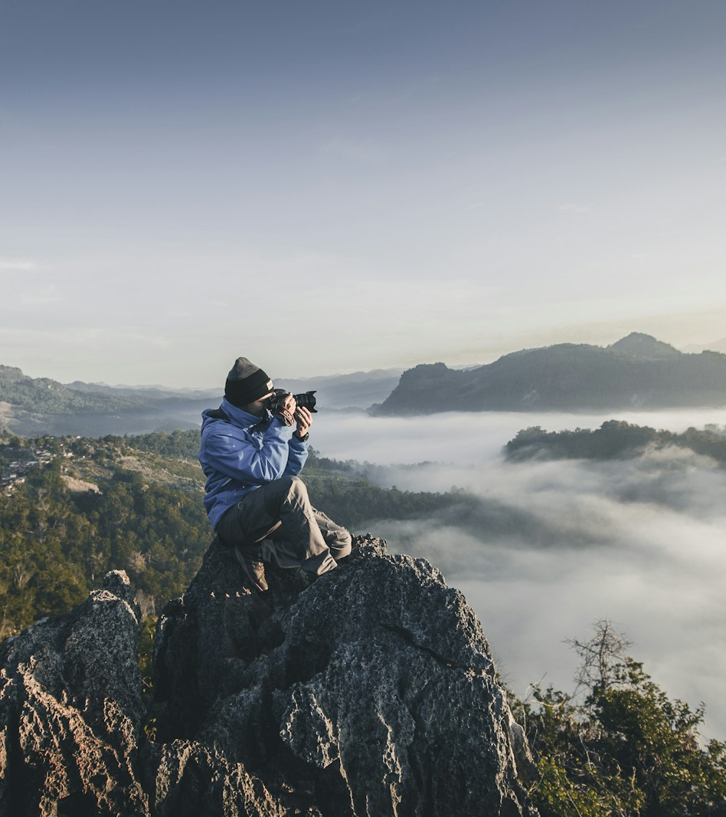
SLOP / UNIVERSITY
SLOP1416
Visual Storytelling
for Short-Form Media
Week 1: Seeing before shooting
Photography, sound, editing and ethical publication
Notes:
Unsplash image asset: https://images.unsplash.com/photo-1492691527719-9d1e07e534b4 (accessed 13 Sep 2026)
Week 1 opening lecture. Course scenario and teaching content are fictional.

Slide 2
SLOP / UNIVERSITY
WEEK 1
Today’s lecture
The course starts with a simple question: what makes a short video worth watching?
1. Observe
2. Plan
3. Assemble
Find a subject, a change and a point of view.
Choose images and sound that serve the story.
Edit the material into a clear experience.
By the end of the session, you can describe a visual story, distinguish shot sizes, and plan a 60-second exercise.
02
Notes:
Lecture roadmap. No external sources used.

Slide 3
SLOP / UNIVERSITY
WEEK 1
What this course studies
Short-form media combines image, sound and sequence. The unit treats a phone or camera as a tool for observation, not as a shortcut to a finished story.
A short video can show:
• a person completing a task
• a place changing over time
• a small decision with consequences
The format is brief. The choices still matter.
03
Notes:
Course framing. Examples are original teaching examples.

Slide 4
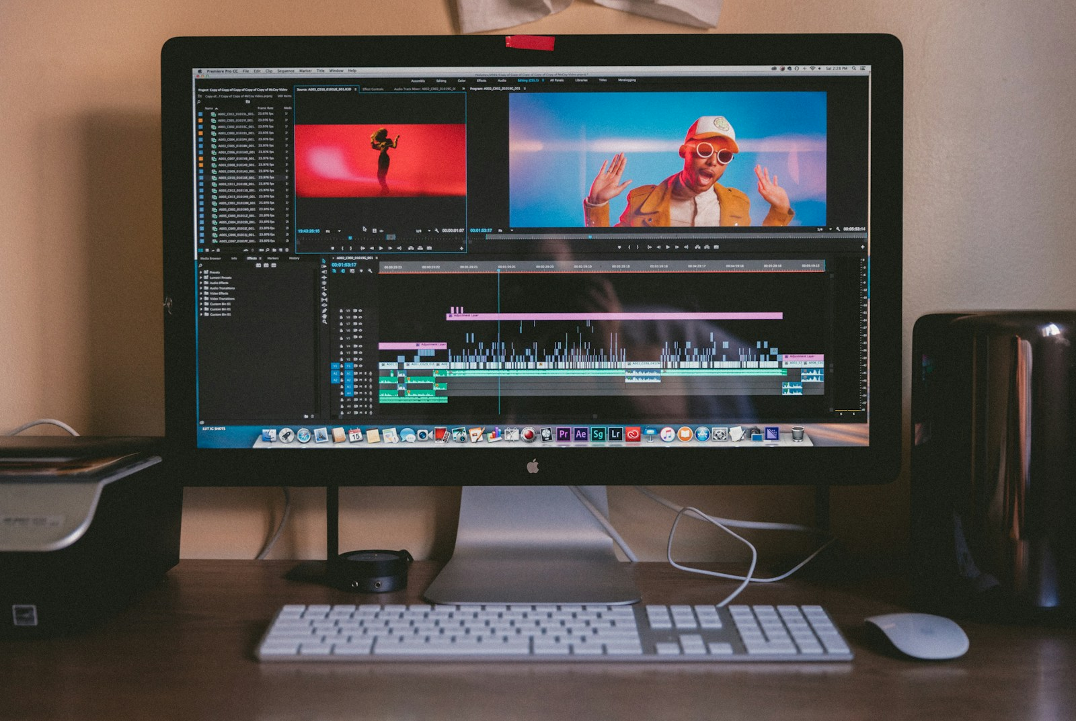
SLOP / UNIVERSITY
WEEK 1
A visual story has a change
The subject does not need to travel far. A story can follow a shift in attention, light, mood, position or understanding.
Question for every shoot
What is different by the final frame?
04
Notes:
Unsplash image asset: https://images.unsplash.com/photo-1492619375914-88005aa9e8fb (accessed 13 Sep 2026)
Teaching question is original.

Slide 5
SLOP / UNIVERSITY
WEEK 1
The basic story unit
A short sequence often works through setup, development and resolution.
SETUP
DEVELOPMENT
RESOLUTION
Where are we? Who or what matters?
What changes, resists or becomes clearer?
What image or sound gives the viewer a stopping point?
This structure guides choices. It does not force every video into the same plot.
05
Notes:
Original teaching framework for this fictional course.

Slide 6
SLOP / UNIVERSITY
WEEK 1
Shot size changes meaning
Wide shot
Medium shot
Close-up
Context and geography
Action and relationships
Detail, emotion and evidence
A useful sequence moves between these distances with a reason.
06
Notes:
Shot-size definitions are standard introductory film vocabulary. No external source quoted.

Slide 7

SLOP / UNIVERSITY
WEEK 1
Composition guides attention
Before recording, decide where the viewer should look first.
Use foreground, framing, contrast and empty space to make the subject legible. Keep backgrounds from competing with the action.
Composition is a decision about emphasis.
07
Notes:
Unsplash image asset: https://images.unsplash.com/photo-1485846234645-a62644f84728 (accessed 13 Sep 2026)
Composition guidance is original course material.

Slide 8
SLOP / UNIVERSITY
WEEK 1
Light establishes tone
Natural light changes quickly. A student filmmaker needs to notice direction, contrast and colour before pressing record.
Front light
Side light
Back light
Shows faces clearly and reduces shadow detail.
Adds shape and texture to a subject.
Creates separation or silhouette when exposed deliberately.
08
Notes:
Introductory lighting terminology. No external source used.

Slide 9
SLOP / UNIVERSITY
WEEK 1
Sound carries place and feeling
Viewers may forgive a handheld image. They rarely forgive sound they cannot understand.
Voice
Record close enough that words remain clear.
Ambient sound
Capture the room, street or workshop before you leave.
Music
Use only material you have permission to include.
09
Notes:
Original teaching guidance. Copyright reminder is general and not legal advice.

Slide 10

SLOP / UNIVERSITY
WEEK 1
Editing creates pace
Editing chooses the order, duration and relationship of shots. The first cut should clarify the story before it tries to impress anyone.
Keep only material that changes what the viewer knows, feels or expects.
10
Notes:
Unsplash image asset: https://images.unsplash.com/photo-1516280440614-37939bbacd81 (accessed 13 Sep 2026)
Editing guidance is original course material.

Slide 11
SLOP / UNIVERSITY
WEEK 1
A simple editing workflow
1
2
3
4
Select
Arrange
Refine
Export
Label usable takes and remove accidents.
Place shots in the order that makes sense.
Adjust duration, sound levels and transitions.
Check captions, file name and intended format.
11
Notes:
Original workflow for introductory class projects.

Slide 12
SLOP / UNIVERSITY
WEEK 1
Ethics before publication
A technically strong video can still cause harm. Ask for permission when a person becomes the subject of your work.
Consent
Context
Care
Explain where the work may appear and respect a refusal.
Avoid editing that changes what a participant meant.
Do not record someone’s distress for a more dramatic image.
12
Notes:
Original course ethics guidance. It complements institutional policy and does not replace it.

Slide 13
SLOP / UNIVERSITY
WEEK 1
The 12-week course arc
01
Seeing and story
07
First assemblies
02
Camera and phone control
08
Continuity and rhythm
03
Light and colour
09
Captions and music
04
Recording sound
10
Style and audience
05
Interviews and observation
11
Peer review
06
Storyboards and planning
12
Screening and portfolio
13
Notes:
Fictional course schedule used consistently across the course site.

Slide 14
SLOP / UNIVERSITY
WEEK 1
Assessment overview
Assignment 1
Final project
60–90 second visual story
40% of final grade
2–3 minute short film
60% of final grade
Both tasks include a short production reflection and a copyright record for any external media.
14
Notes:
Fictional assessment design for the course website. Weights total 100%.

Slide 15

SLOP / UNIVERSITY
WEEK 1
Week 1 field exercise
In pairs, record six shots that show a routine changing: arriving, preparing, making, waiting, leaving or cleaning up.
No dialogue required. Capture at least one wide shot, one medium shot, one close-up and ten seconds of ambient sound.
15
Notes:
Unsplash image asset: https://images.unsplash.com/photo-1516321318423-f06f85e504b3 (accessed 13 Sep 2026)
Original classroom exercise.

Slide 16
SLOP / UNIVERSITY
WEEK 1
Shooting checklist
Story
Can you explain the change in one sentence?
Image
Do the first and final frames have a purpose?
Sound
Did you monitor dialogue and room tone?
Permission
Does every identifiable participant understand the use?
Backup
Did you copy files before deleting material?
16
Notes:
Original field checklist.

Slide 17
SLOP / UNIVERSITY
WEEK 1
Critique vocabulary
A useful critique names an observable choice, describes its effect, then asks a question that helps the maker revise.
Framing
What does the frame include or exclude?
Rhythm
Where does the piece speed up or pause?
Continuity
Can the viewer follow time and space?
Point of view
Whose experience shapes the sequence?
17
Notes:
Original critique prompts for peer review.

Slide 18
SLOP / UNIVERSITY
WEEK 1
What to bring next week
Bring a phone or camera that records video. Bring headphones if you own them. Install or identify one editing tool you can access consistently.
Preparation task
Watch a short video you admire twice. First, watch normally. Then list every shot change and every sound you notice.
18
Notes:
Original preparation task. No specific external video is prescribed.

Slide 19
SLOP / UNIVERSITY
WEEK 1
Key ideas from Week 1
1
A short video needs a point of view and a change.
2
Shot size, composition, light and sound guide attention.
3
Editing gives recorded material an order and a pace.
4
Consent and context shape responsible publication.
19
Notes:
Week 1 recap. Original course content.

Slide 20
NEXT: CAMERA AND PHONE CONTROL
Make one deliberate
minute of footage
Start with an ordinary action. Decide what should change. Record with enough care that another person can follow it.
SLOP1416 · Visual Storytelling for Short-Form Media
Notes:
Closing prompt. Original course content.

